Slide 1
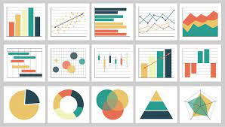
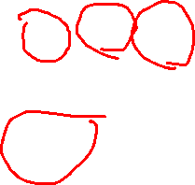
PYTHON FOR DATA VISUALIZATION SCATTER PLOT
Name: Vaka Prasanna
Roll No: 20BQ1A05O6
Section: 4-cse-d
Subject: data science
College: vasireddy Venkatadri institute of technology

Slide 2
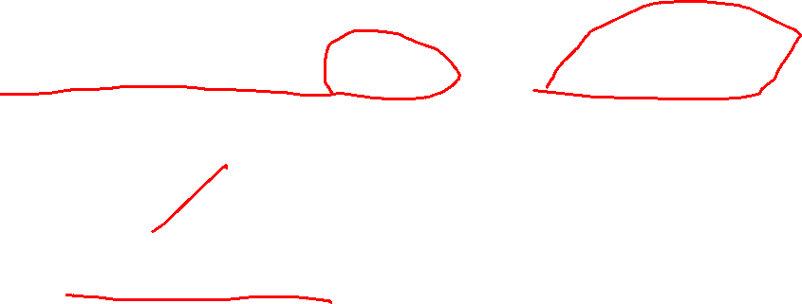
PYTHON FOR DATA VISUALIZATION
The process of finding trends and correlations in our data by representing it pictorially is called Data Visualization.
To perform data visualization in Python, we can use various Python data visualization modules.

Slide 3
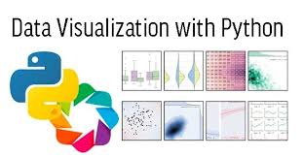

PYTHON FOR DATA VISUALIZATION
Python provides various libraries that come with different features for visualizing data.
All these libraries come with different features and can support various graphs.
Matplotlib
Seaborn
Plotly etc.

Slide 4
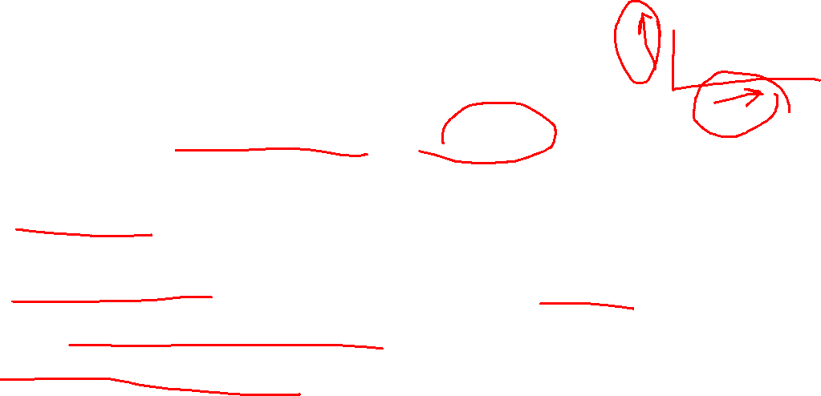
SCATTER PLOTS
Scatter plots are graphs that present the relationship between two variables in a data set.
It represents data points on a two-dimensional plane or a Cartesian system.
The independent variable is plotted on the X-axis, while the dependent variable is plotted on the Y-axis.
These plots are often called scatter graphs or scatter diagrams.

Slide 5
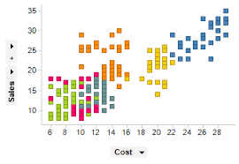
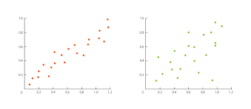
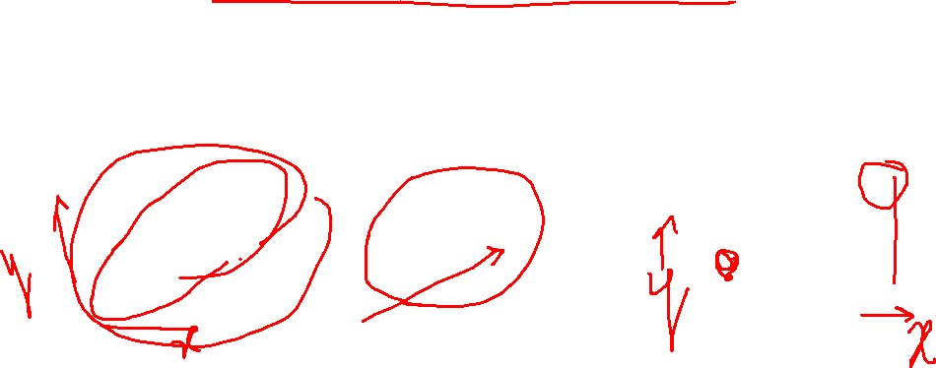
SCATTER PLOTS
Scatter plots are used when we have to plot two or more variables present at different coordinates.
The data is scattered all over the graph

Slide 6
SCATTER PLOT Properties
Marker Symbol => default ‘o’ , ‘+’, ‘*’, ‘p’, ’^’ etc.
Linewidth => width of marker line, default 0.5
MarkerEdgeColor=> outline color of marker
MarkerFaceColor => Fill color of the marker

